Slide 1
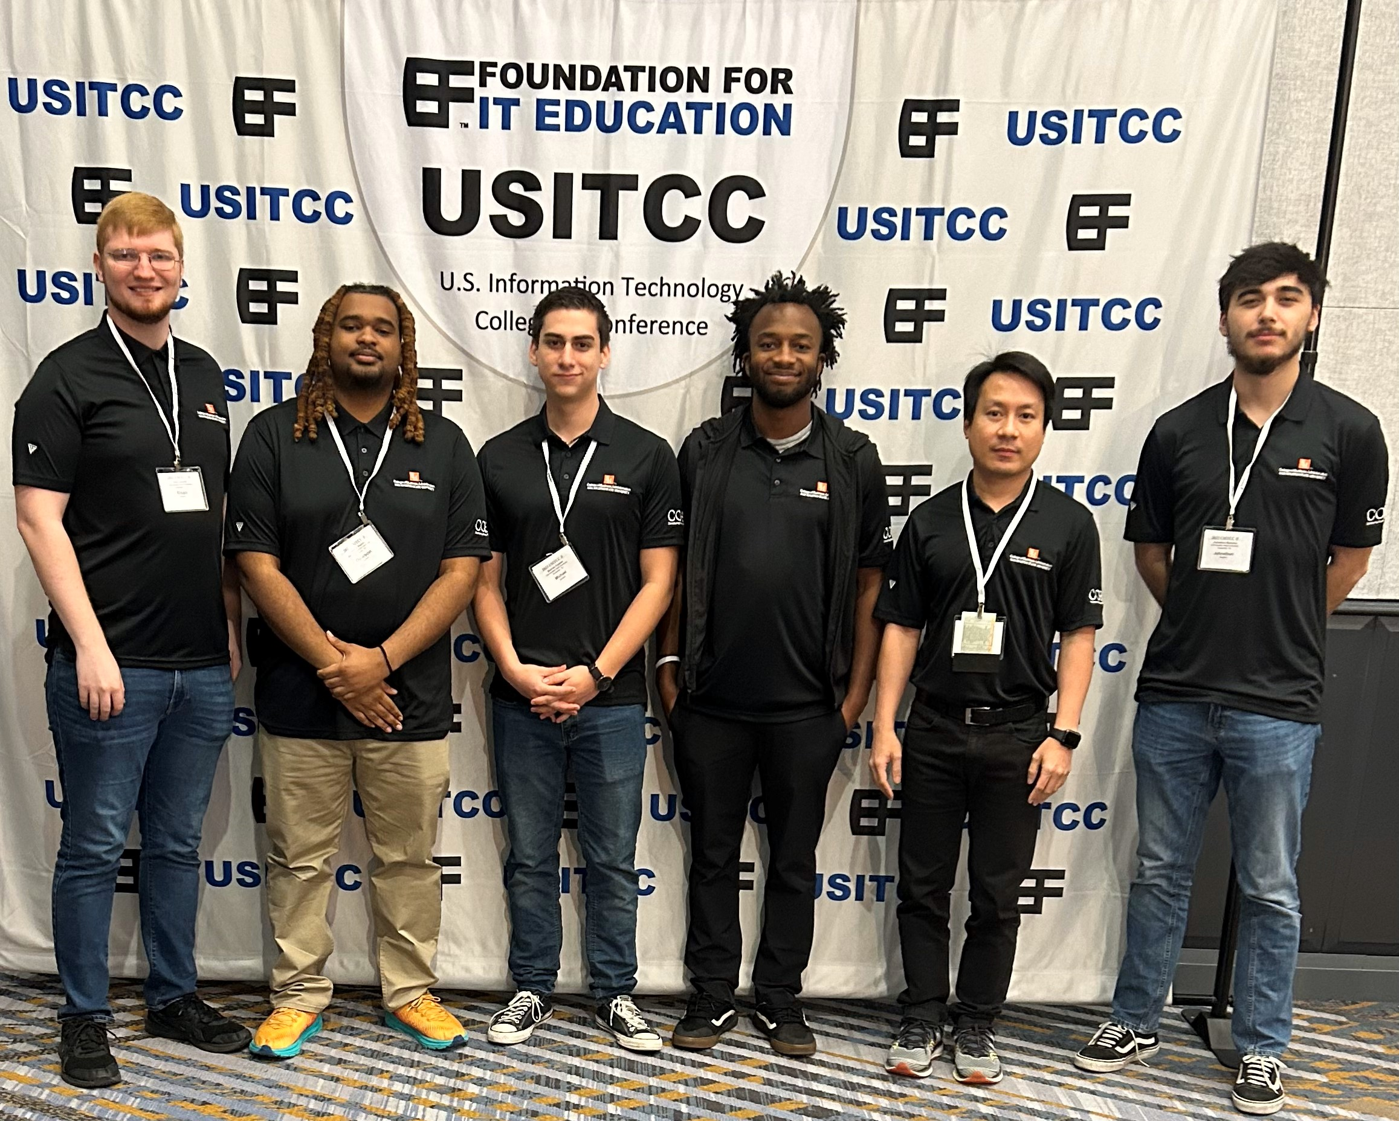
USITCC Spring 2023
Noah Grenier, Michael Peeples, Dawson Watkins, Johnathon Renteria, Ronnie J

Slide 2
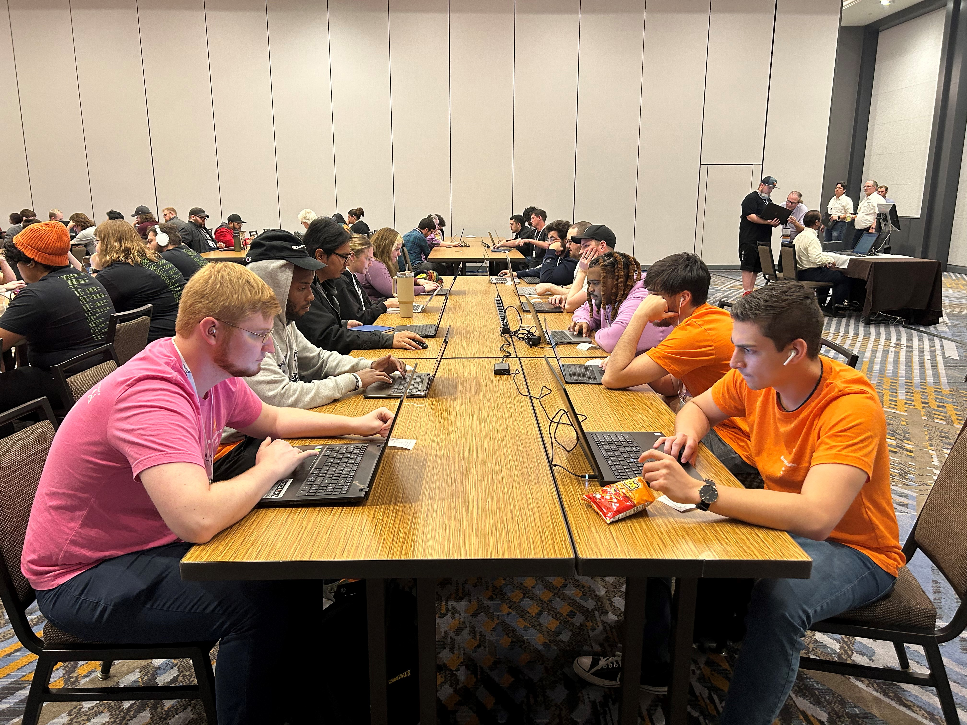
What it is
Series of four competitions that can include:
System Analysis and Design
Database
Security
PC Troubleshooting
Microsoft Office
Software Development
Possible certifications that are free to try

Slide 3
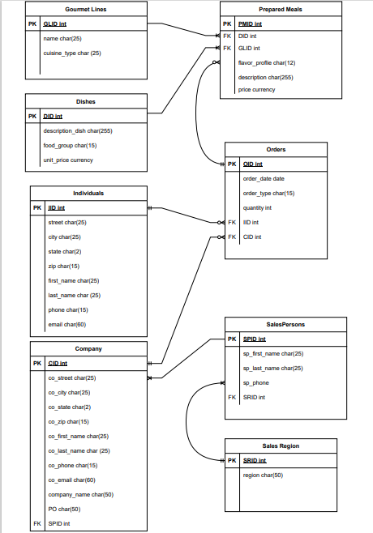
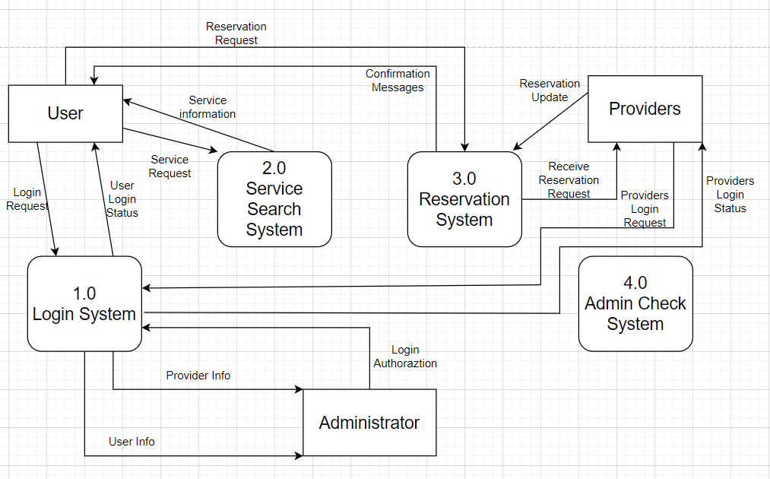
What we learned
We got hands on experience with realistic problems
Got to meet with professors and students from other schools
Learned what we know, and we need to work on

Slide 4
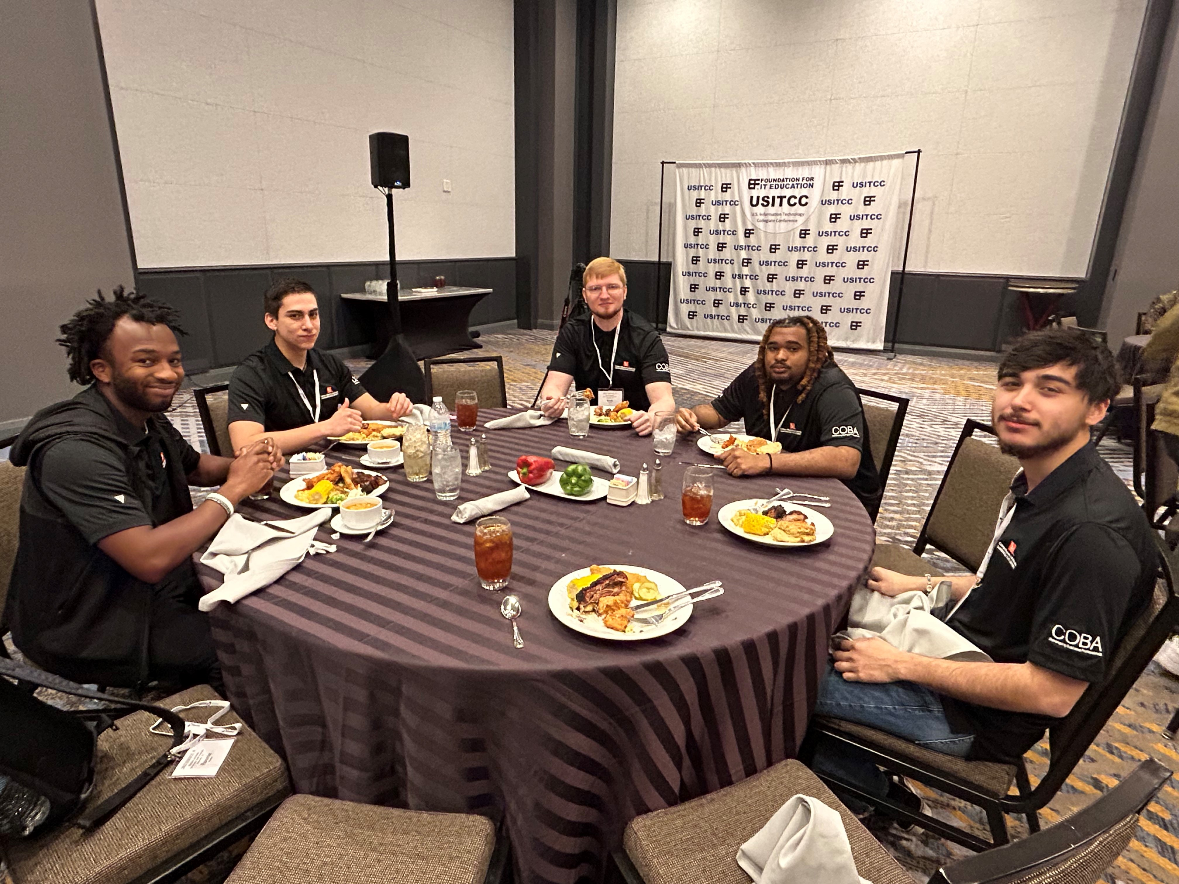
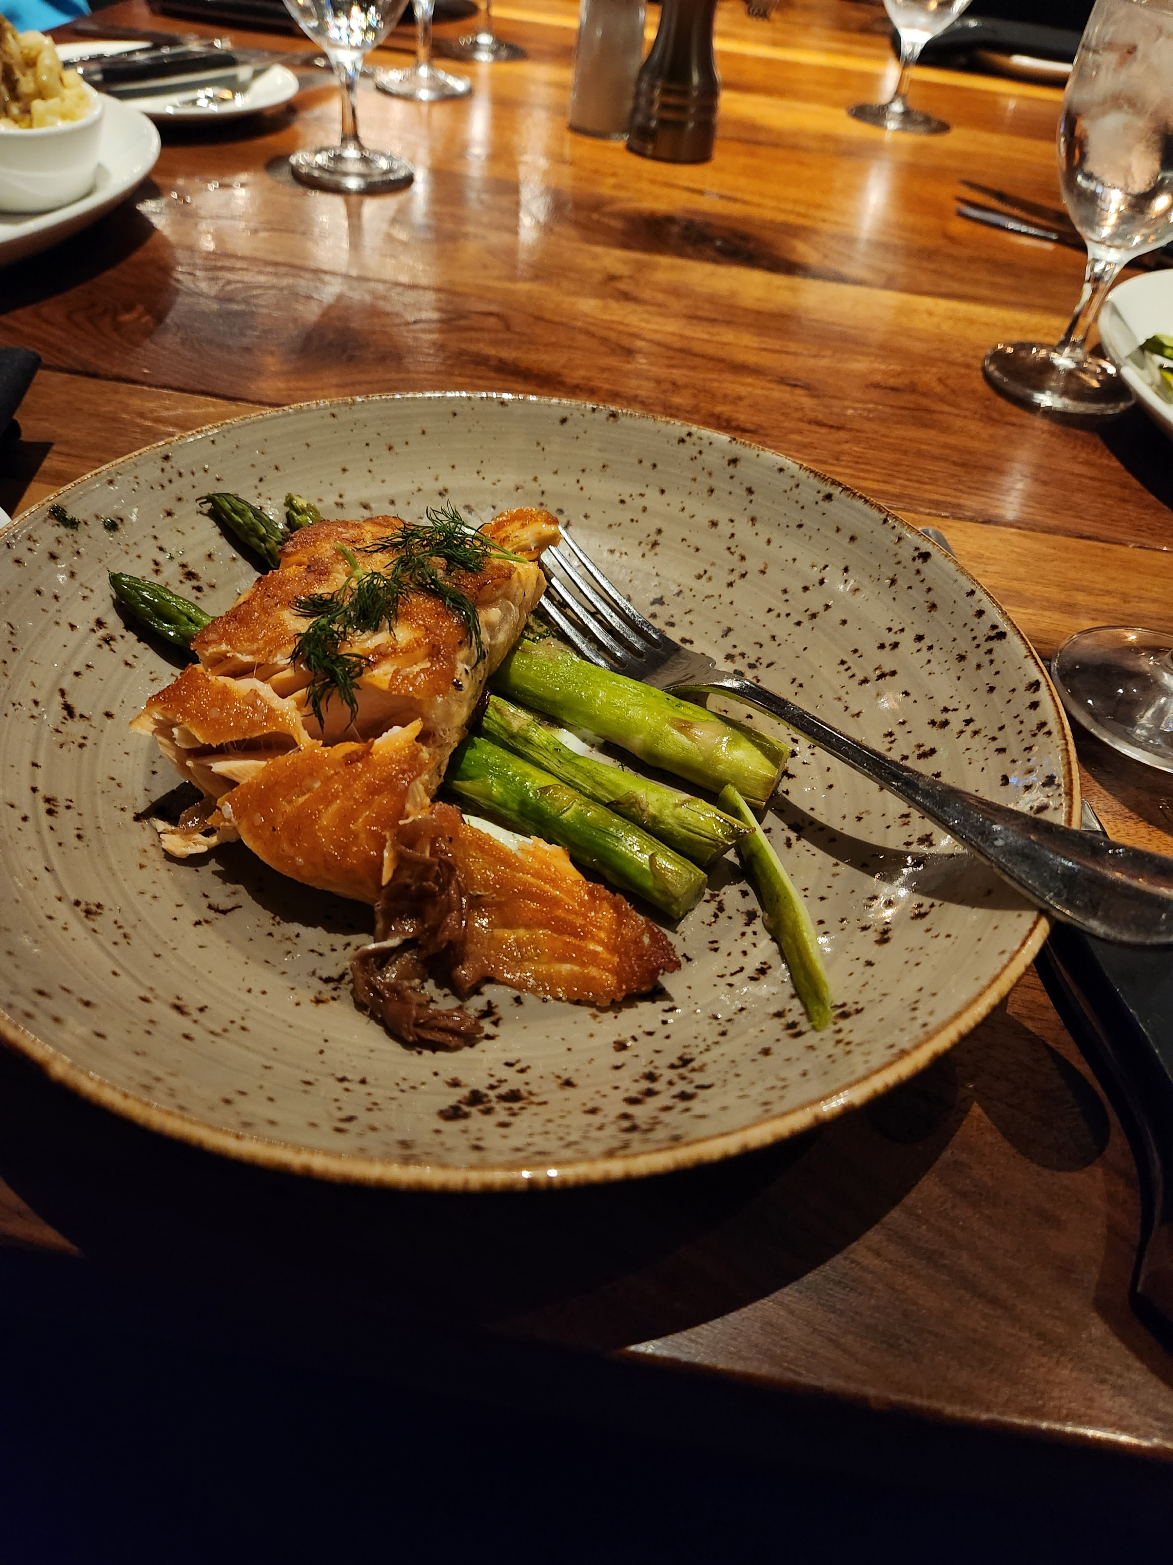
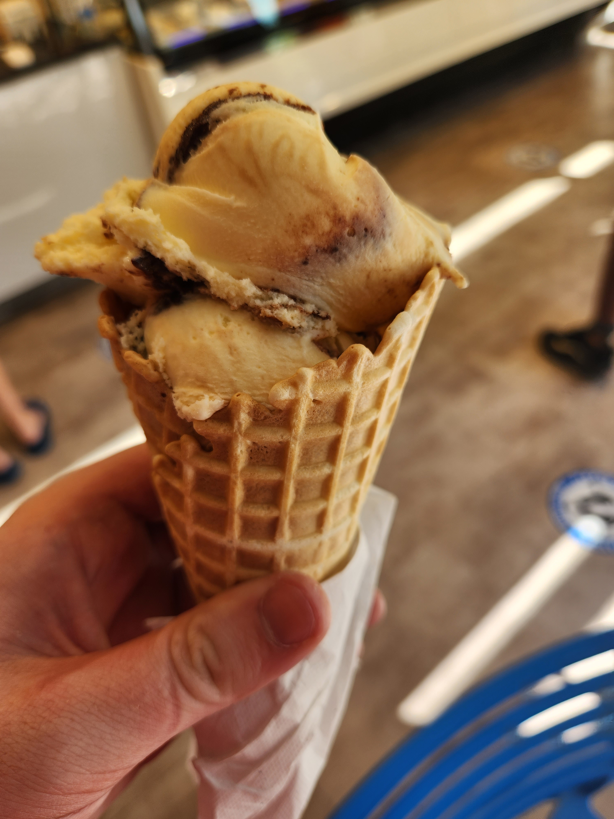
We had fun
Nice hotel with good food and every person at the conference was nice, just prepared for some people to walk up and talk to you

Slide 5

ICCP & CS Certification
There are opportunities to earn certifications at these events and are free to take

Slide 6
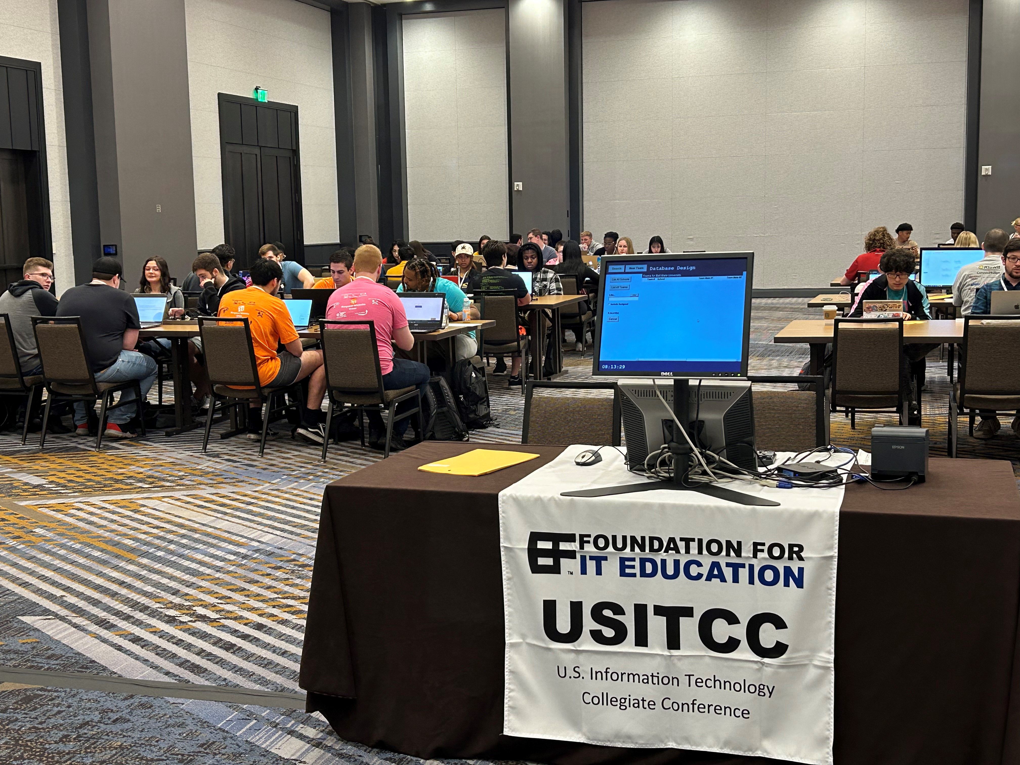
THANK YOU

